Slide 1
P329 Participant Test Briefing
Public
5 April 2017
Mahesh Gogtay

Slide 3
Agenda
Introductions 10:30
Walkthrough of the Participant Test Plan 10:40
Amendments to MODIS User Interface 10:50
Amendments to ELEXON Portal 11:10
Live Cut-over 11:15
Next Steps 11:20
Q&A 11:25
Lunch 11:55

Slide 4
Walkthrough of the Participant Test Plan
Mahesh Gogtay

Slide 5
Walkthrough of the Participant Test Plan

Slide 6
Amendments to MODIS
National Grid

Slide 7



Amendments to MODIS ACER REMIT Screens
David Preston – Business Lead, Strategic Projects
Jayati Dwivedi – MODIS Test Lead / IS Contact

Slide 8
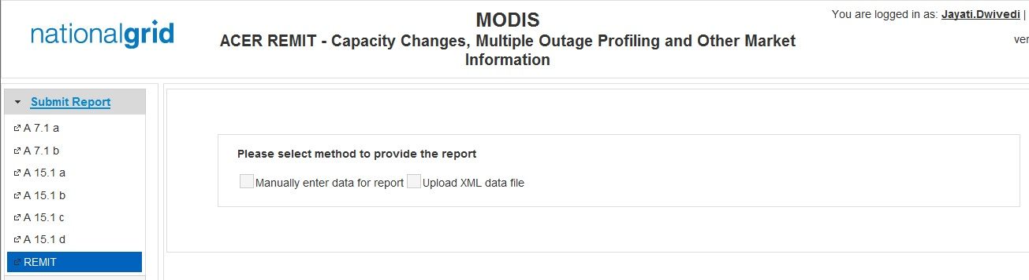
MODIS ACER REMIT Homepage
Amendment on existing REMIT screen

Slide 9
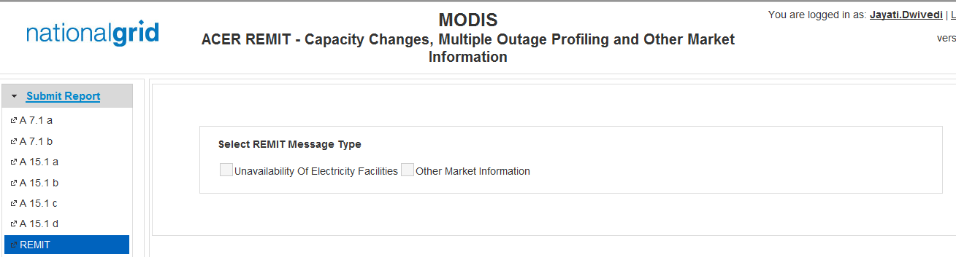
MODIS ACER REMIT Manual Data Entry Screen
This is a new screen on MODIS REMIT page

Slide 10
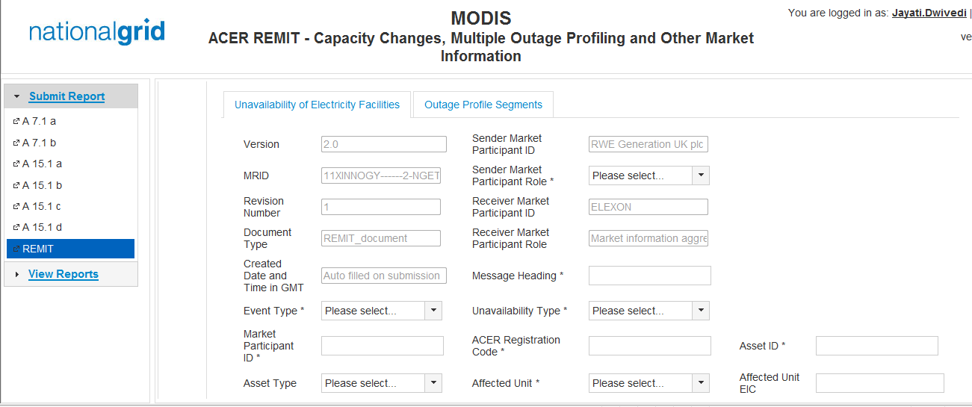
Unavailability of Electricity Facility Screen
Amendments to the existing fields
Addition of new fields

Slide 11
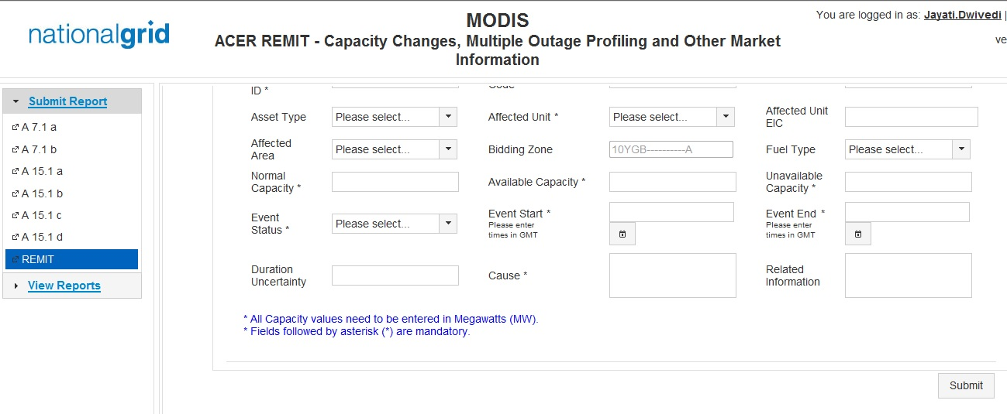
Unavailability of Electricity Facility Screen
Amendments to the existing fields
Addition of new fields

Slide 12
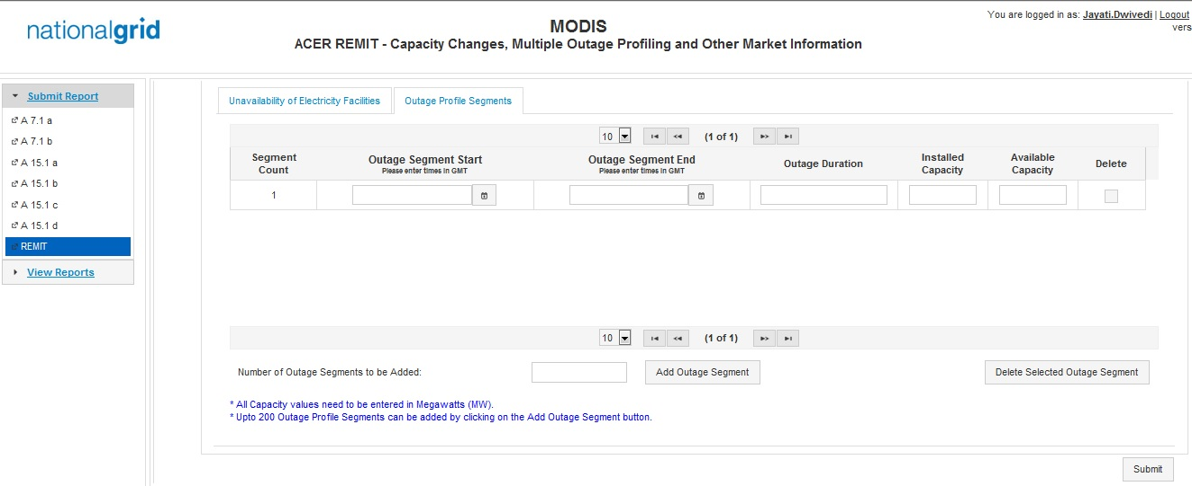
Optional Outage Profile Screen for UoEF
Amendments to the existing fields
Addition of new screen/ fields

Slide 13
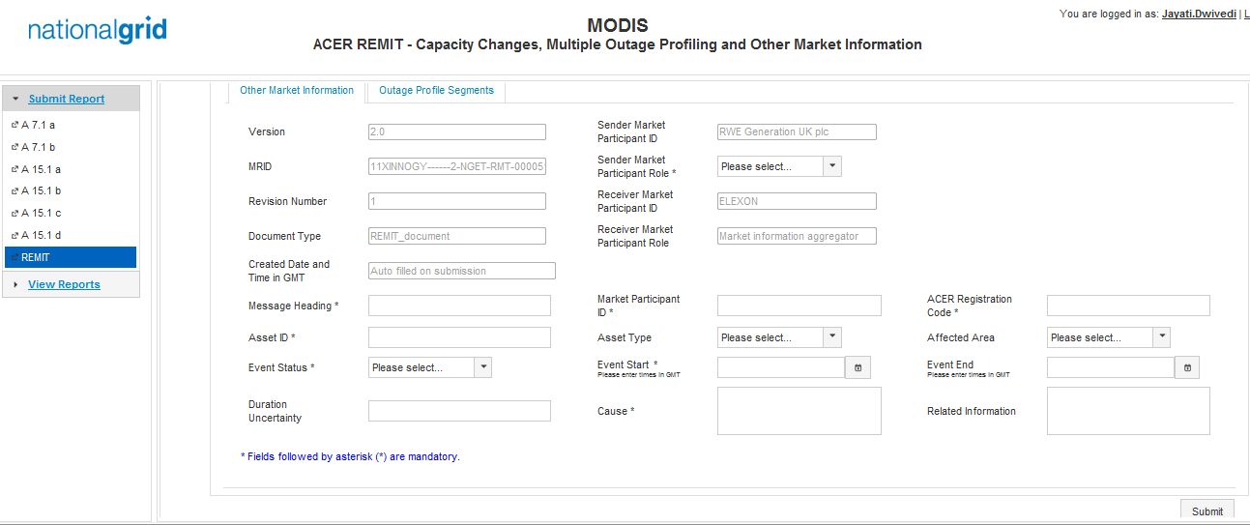
Other Market Information Screen
Amendments to the existing fields
Addition of new fields

Slide 14
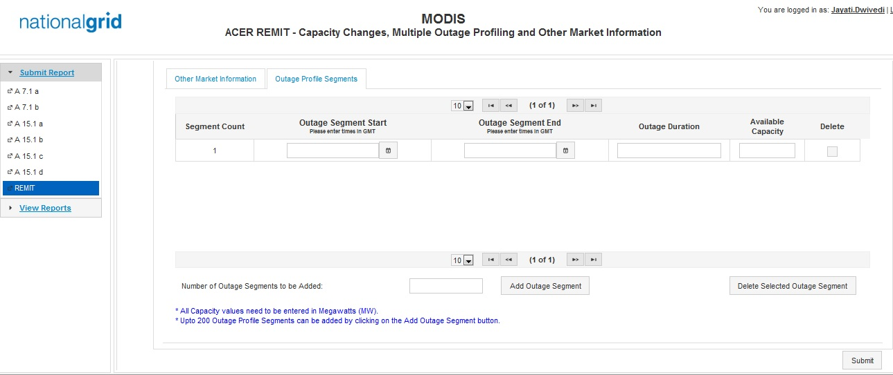
Optional Outage Profile Screen for OMI
Amendments to the existing fields
Addition of new fields

Slide 15
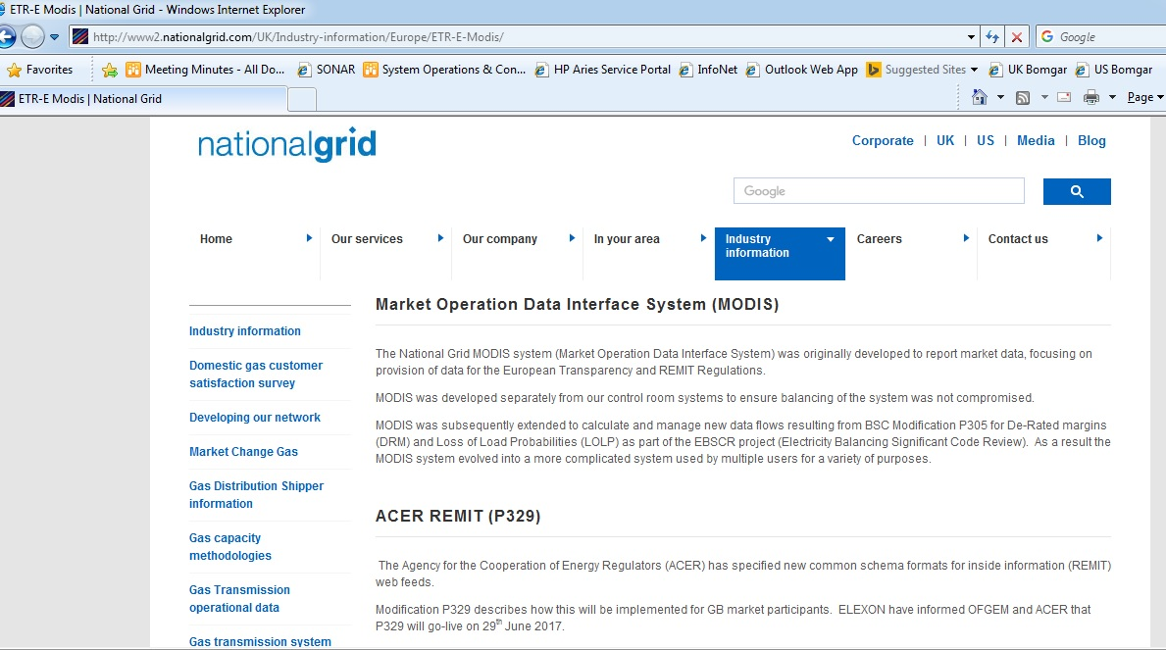
Link to National Grid MODIS Webpage
URL - http://www2.nationalgrid.com/UK/Industry-information/Europe/ETR-E-Modis/

Slide 16
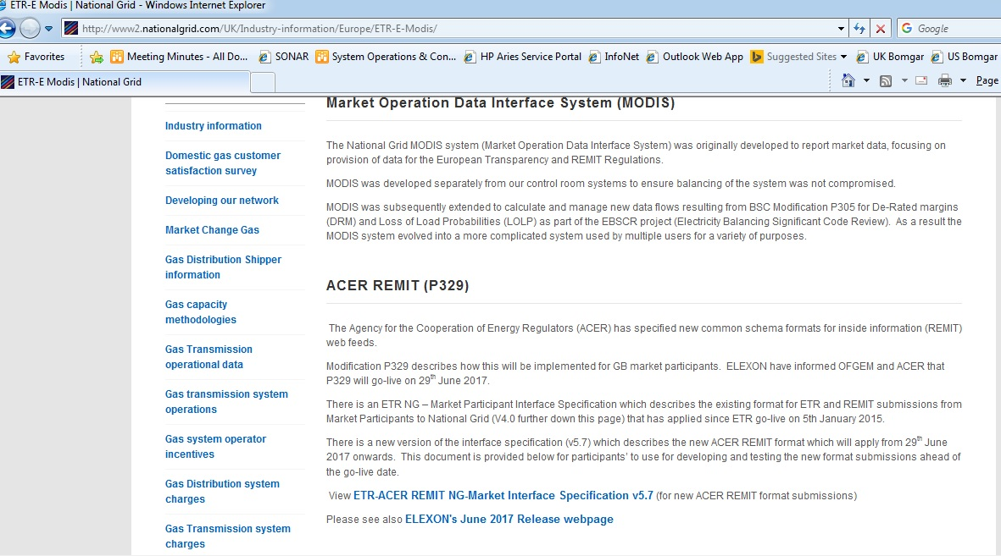
National Grid MODIS Documents Location
URL - http://www2.nationalgrid.com/UK/Industry-information/Europe/ETR-E-Modis/

Slide 17
Key Contacts within National Grid
Business
Business Expert – richard.j.price@nationalgrid.com
Business User – sophie.delamasantiere@nationalgrid.com
Business Lead – david.a.preston@nationalgrid.com
IS
Test Lead – Jayati.Dwivedi@nationalgrid.com
Project Manager – sanjeev.gopalakrishnan@nationalgrid.com
Programme Manager – stephen.barclay@nationalgrid.com
Design Authority – Muslim.Jagani@nationalgrid.com

Slide 18
Amendments to ELEXON Portal
Zaahir Ghanty

Slide 19
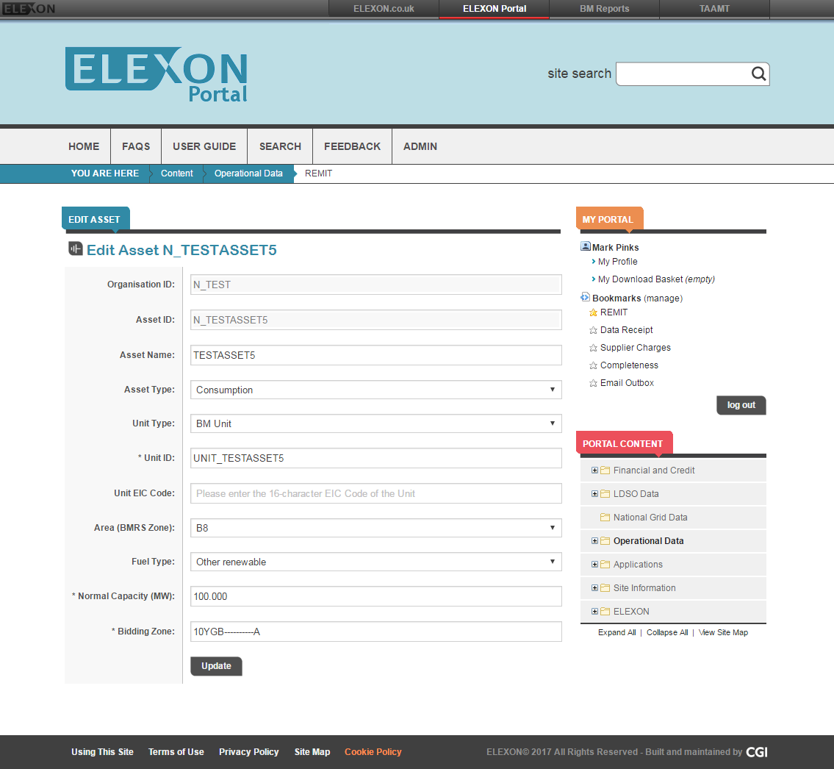
Edit Assets

Slide 20
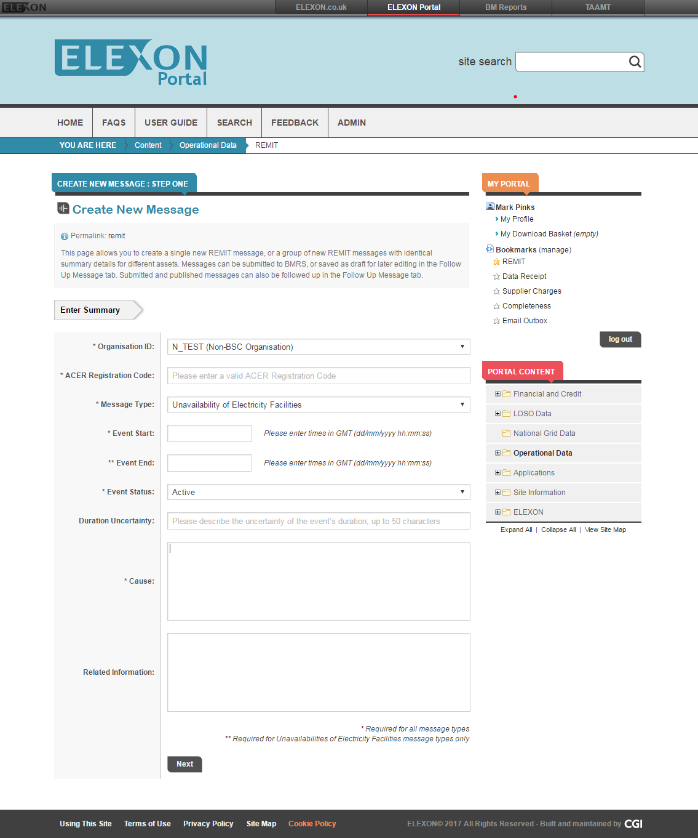
Create Message Screen 1

Slide 21
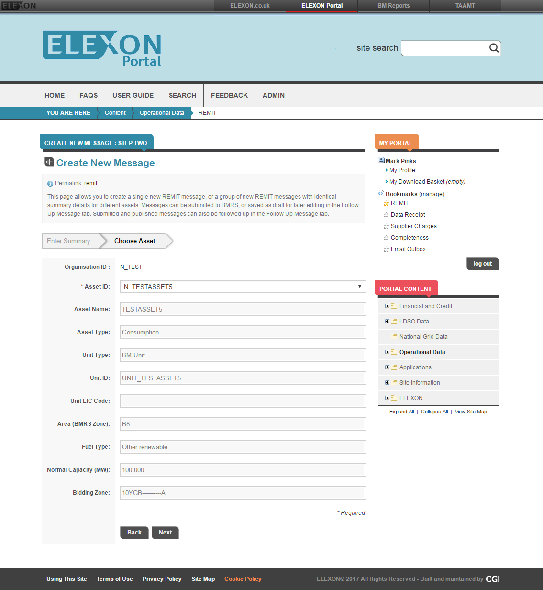
Create Message Screen 2

Slide 22
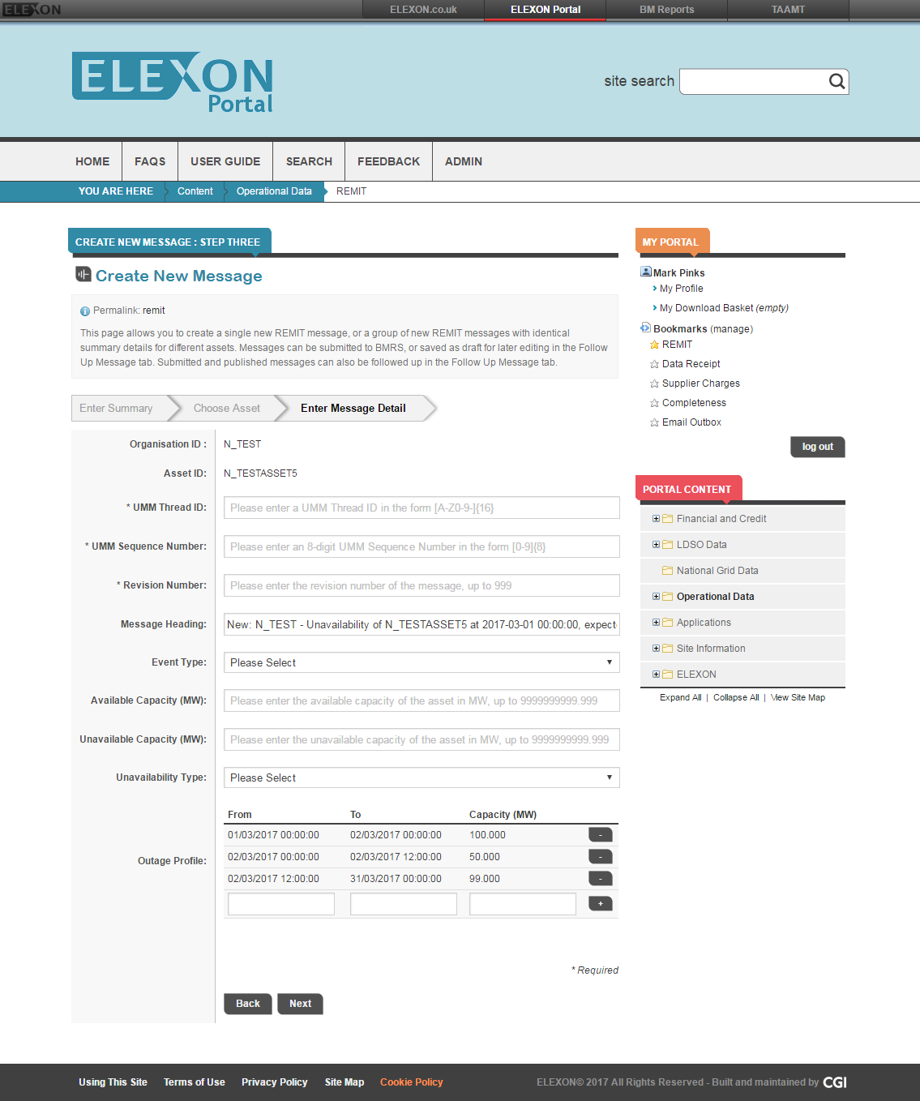
Create Message Screen 3

Slide 23
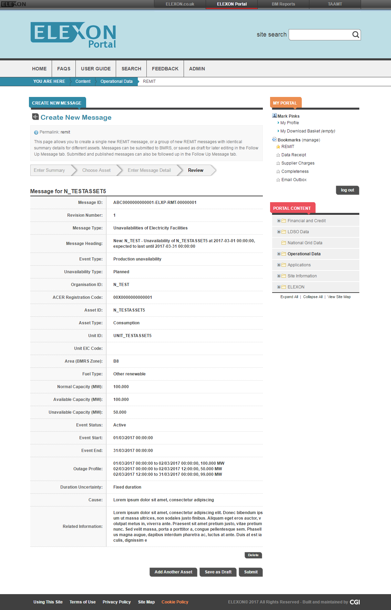
Create Message Screen 4

Slide 24
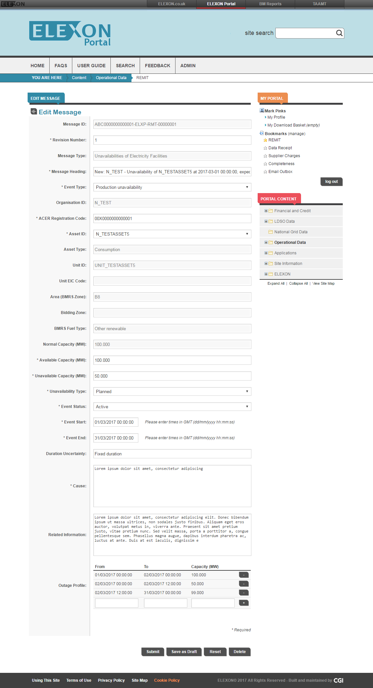
Follow-up Message

Slide 25
Live Cut-over
Mahesh Gogtay

Slide 26
Live cut-over
Headline: REMIT downtime: from 28 June 2017 pm to 29 June 2017 am
Old XSD format: until 28 June 2017 19:00
New XSD format: from 29 June 2017 09:15
* Please note these are indicative timings. Exact timings will be confirmed in the w/c 19 June.
Application | Down from | Back at
MODIS | 28 June 2017 19:00 | 29 June 2017 09:15
Portal - REMIT | 28 June 2017 19:00 | 29 June 2017 09:15
BMRS | 28 June 2017 20:00 | 29 June 2017 09:00

Slide 27
Next Steps
Mahesh Gogtay

Slide 28
Next steps
Register your interest in test participation by emailing releases@elexon.co.uk with
  your contact details
  tests interested in (MODIS/Portal, APIs)
  dates for testing
  Email any comments to releases@elexon.co.uk and Jayati.Dwivedi@nationalgrid.com by 14 April
  We will publish the final test plan by 28 April
  Additionally, register interest for P321 testing by emailing releases@elexon.co.uk
  new Trading Unit Data page
  new API

Slide 29
Q&A

